Slide 1
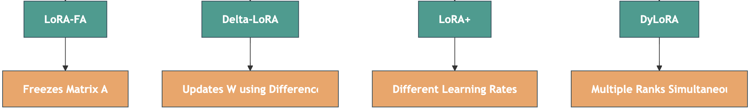
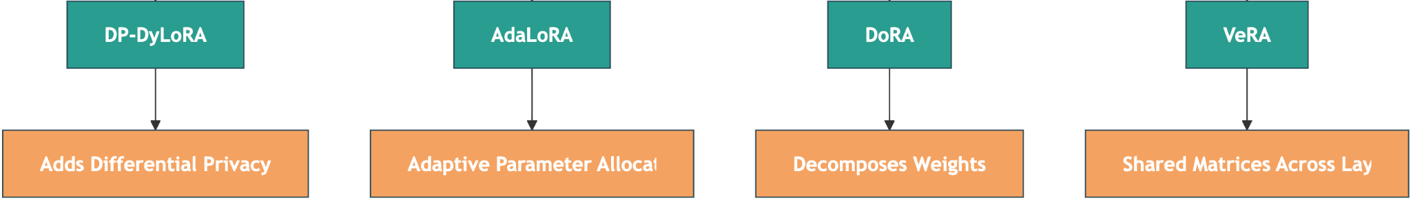
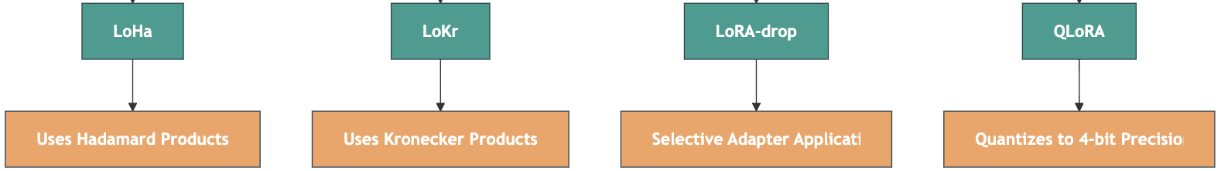
LoRA variants for efficient LLM Fine-Tuning

Slide 2
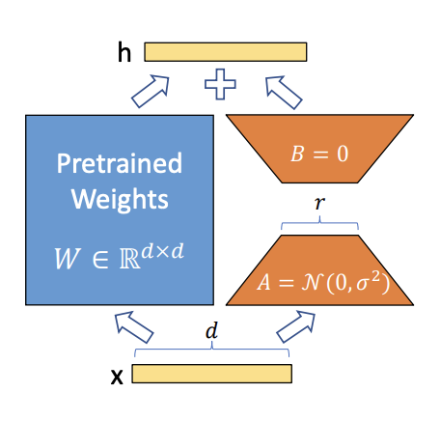
1. LoRA (Low-Rank Adaptation)

Slide 3
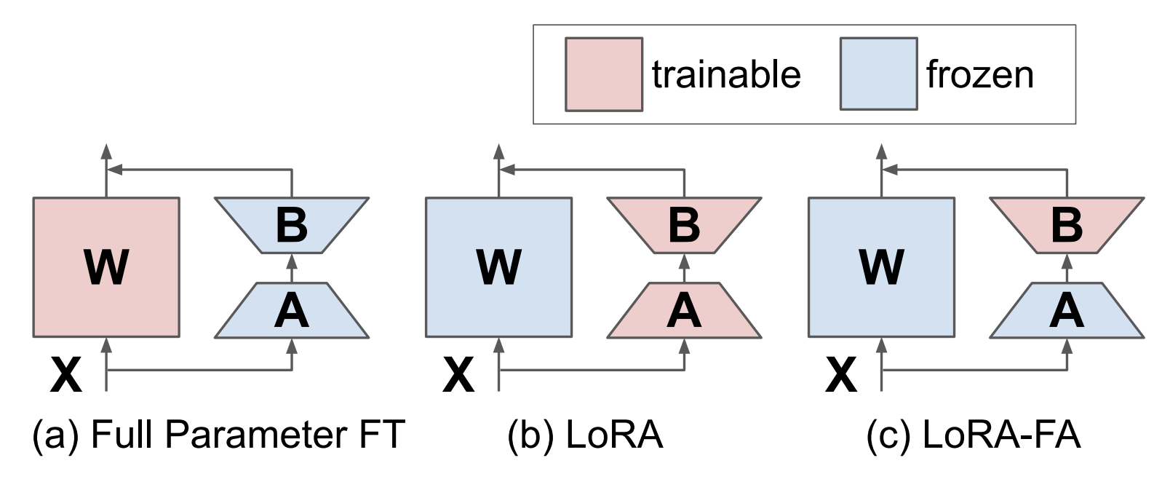
2. LoRA-FA (Frozen-A)

Slide 4
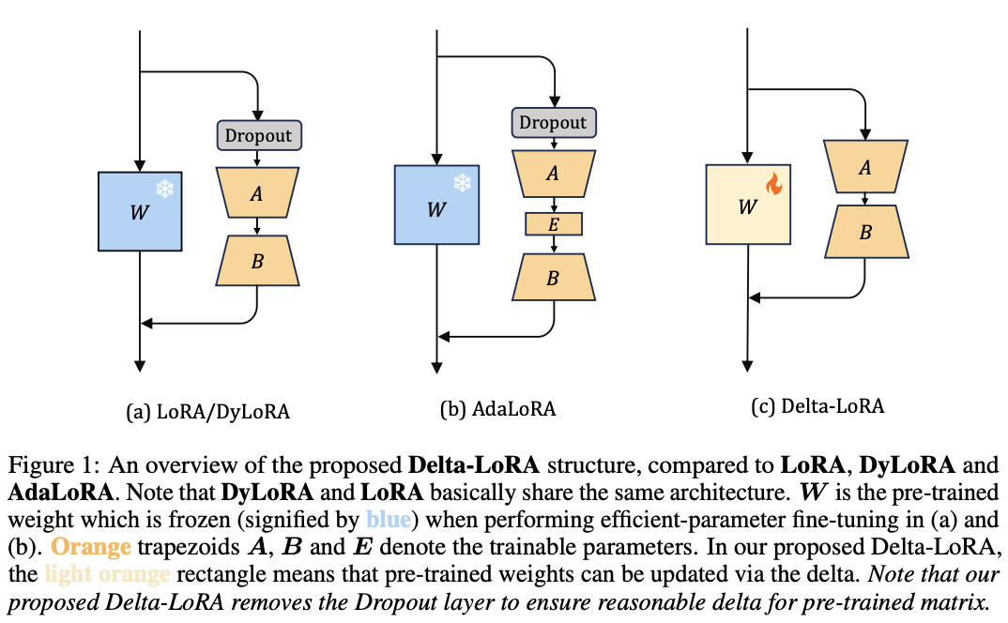
3. Delta-LoRA

Slide 5
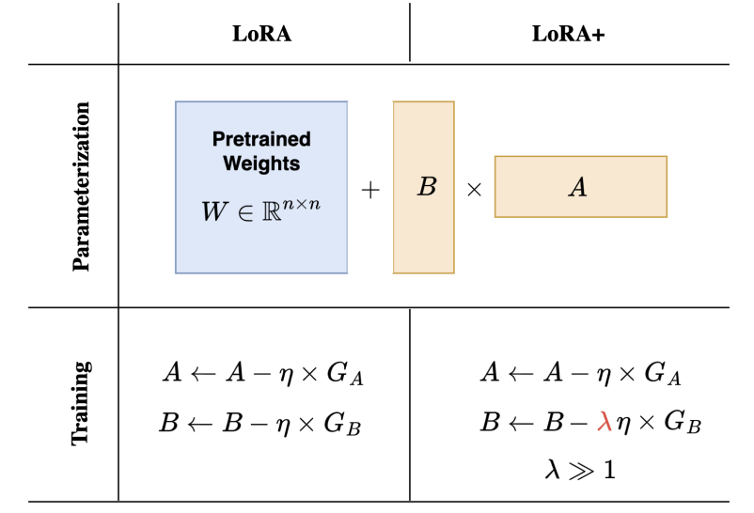
4. LoRA+

Slide 6
5. DyLoRA (Dynamic LoRA)

Slide 7
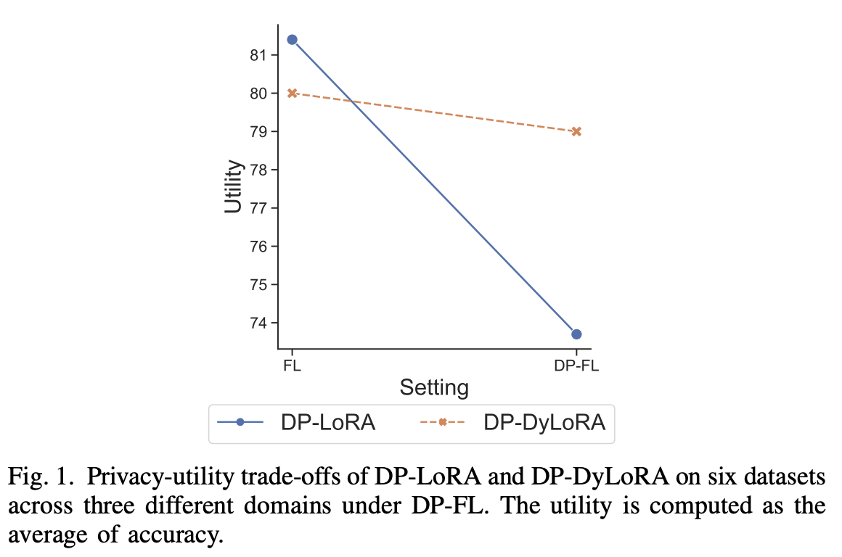
6. DP-DyLoRA

Slide 8
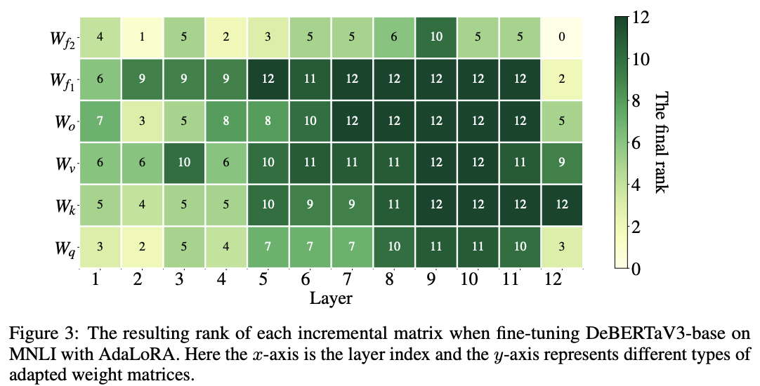
7. AdaLoRA (Adaptive LoRA)

Slide 9
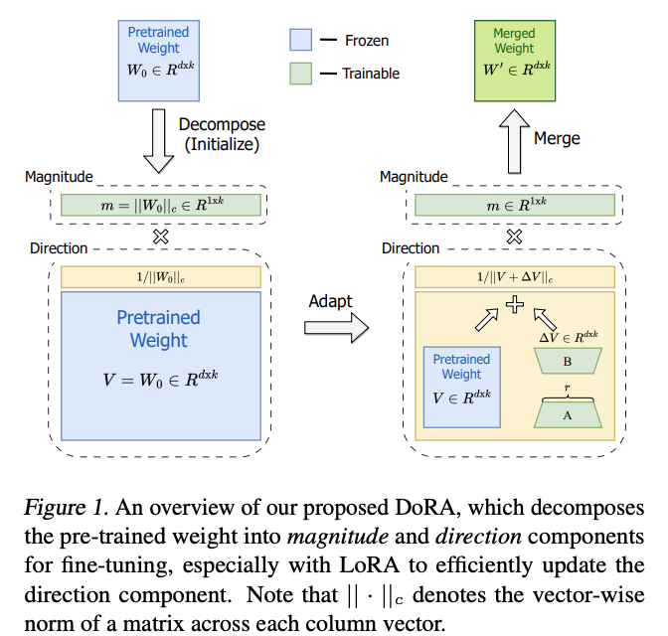
8. DoRA (Decomposed LoRA)

Slide 10
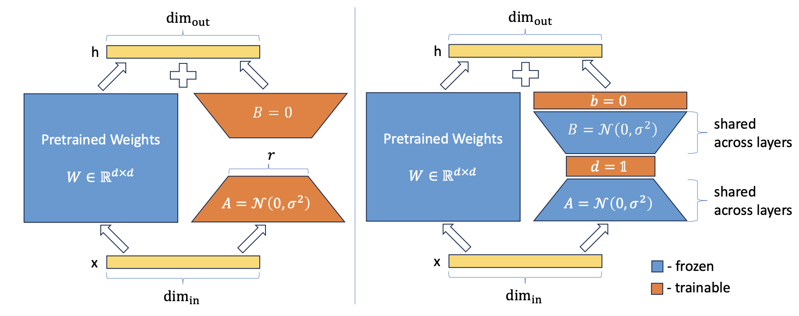
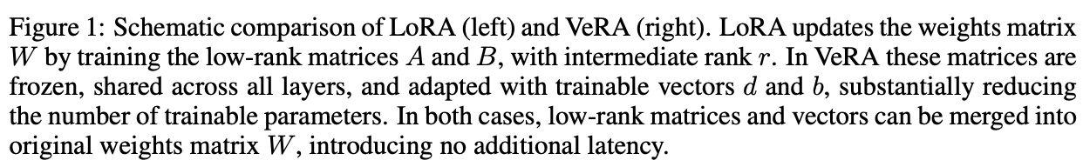
9. VeRA (Vector-based Random Matrix Adaptation)

Slide 11
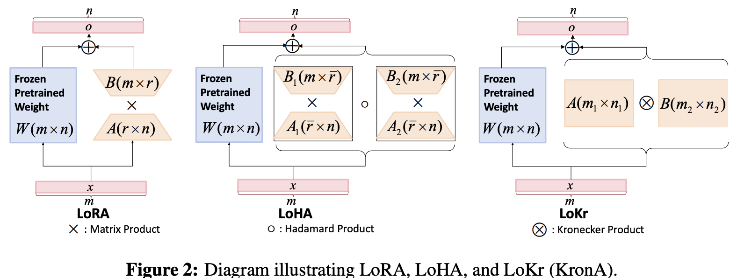
10. LoHa (Low-Rank Hadamard Product)

Slide 12
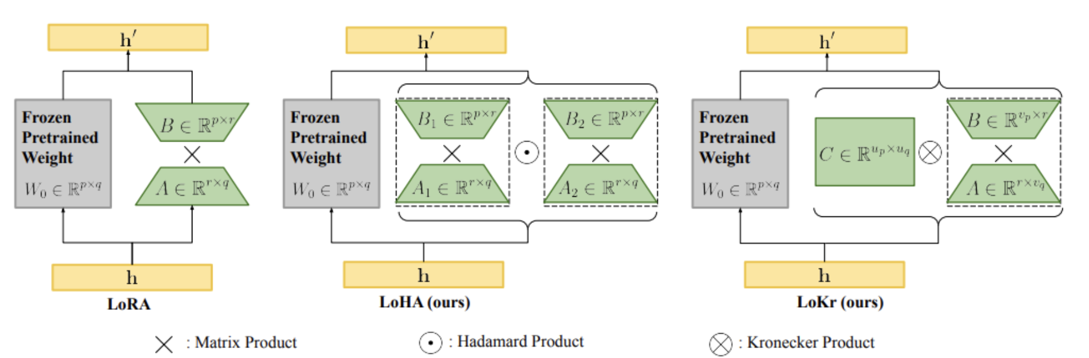
11. LoKr (Low-Rank Kronecker Product)

Slide 13
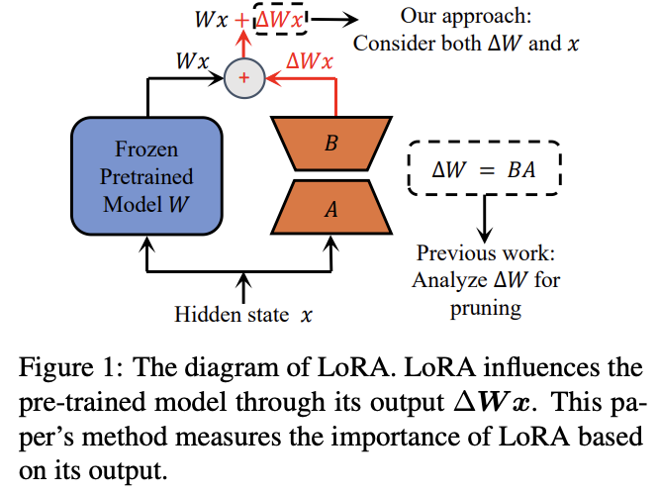
12. LoRA-drop

Slide 14
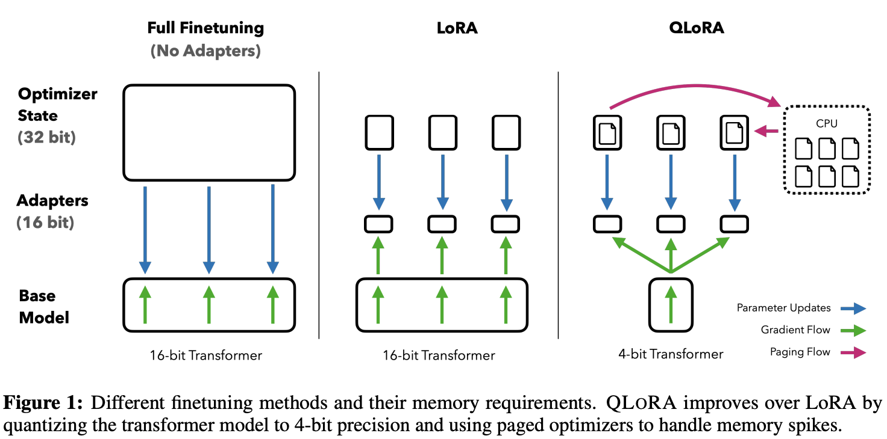
13. QLoRA (Quantized LoRA)

Slide 15

Download Complete Guide ⬇️
https://github.com/Abonia1/lora-llm-fientuning

